Slide 1
Universal Human Values HMCO4060T

Slide 2
Examination Scheme
Credits : 02
Term Test : 15 Marks
Teacher Assessment : 20 Marks
End Sem Exam : 65 Marks
Total Marks : 100 Marks
Course Objectives:
1. Development of a holistic perspective based on self-exploration about themselves (human being), family, society and nature/existence.
2. Understanding (or developing clarity) of the harmony in the human being, family, society and nature/existence.
3. Strengthening of self-reflection.
4. Development of commitment and courage to act.

Slide 3
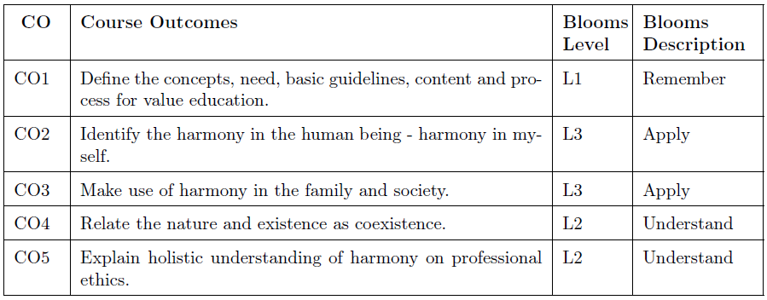

Slide 4
Unit-I
Introduction: Need, Basic Guidelines, Content and Process for Value Education Purpose and Motivation for the Course, Self-exploration–What Is It? - Its Content and Process; ‘Natural Acceptance’ and Experiential Validation- as the Process for Self-Exploration. Continuous Happiness and Prosperity- A Look at Basic Human Aspirations. Right Understanding, Relationship and Physical Facility- The Basic Requirements for Fulfilment of Aspirations of Every Human Being with their Correct Priority. Understanding Happiness and Prosperity Correctly- A Critical Appraisal of the Current Scenario. Method to Fulfil the Above Human Aspirations: Understanding and Living in Harmony at Various Levels.

Slide 5
Unit-II Understanding Harmony in the Human Being - Harmony in Myself!
Understanding Human Being as a Co-Existence of the Sentient ‘I’ and the Material ‘Body’.
Understanding the Needs of Self (‘I’) and ‘Body’ - Happiness and Physical Facility.
Understanding the Body as an Instrument of ‘I’ (I Am Being the Doer, Seer and Enjoyer).
Understanding the Characteristics and Activities of ‘I’ and Harmony in ‘I’.
Understanding the Harmony of I with the Body: Sanyam and Health; Correct Appraisal of Physical
Needs, Meaning of Prosperity in Detail.
Programs to Ensure Sanyam and Health.

Slide 6
Unit-III Understanding Harmony in the Family and Society: Harmony in Human-Human Relationship
Understanding Values in Human-Human Relationship; Meaning of Justice (Nine Universal Values in
Relationships) and Program for its Fulfillment to Ensure Mutual Happiness; Trust and Respect as the Foundational Values of Relationship.
Understanding the Meaning of Trust; Difference Between Intention and competence.
Understanding the Meaning of Respect, Difference Between Respect and Differentiation, the OtherSalient Values in Relationship.
Understanding the Harmony in the Society (Society Being an Extension of Family): Resolution, Prosperity,Fearlessness (Trust) and Co-Existence as Comprehensive Human Goals.
Visualizing a Universal Harmonious Order in Society- Undivided Society, Universal Order from Family to World Family.

Slide 7
Unit-IV Understanding Harmony in the Nature and Existence: Whole Existence as Coexistence
Understanding the Harmony in the Nature 19. Interconnectedness and Mutual Fulfillment Among the Four Orders of Nature Recyclability and Self-Regulation in Nature.
Understanding Existence as Coexistence of Mutually Interacting Units in All Pervasive Space.
Holistic Perception of Harmony at All Levels of Existence.

Slide 8
Unit-V Implications of the Above Holistic Understanding of Harmony on Professional Ethics
Natural Acceptance of Human Values 23. Definitiveness of Ethical Human Conduct.
Basis for Humanistic Education, Humanistic Constitution and Humanistic Universal Order.
Competence in Professional Ethics:
a. Ability to Utilize the Professional Competence for Augmenting Universal Human Order.
b. Ability to Identify the Scope and Characteristics of People Friendly and Eco-Friendly Production
Systems.
c. Ability to Identify and Develop Appropriate Technologies and Management Patterns for Above

Slide 9
Production Systems.
Case Studies of Typical Holistic Technologies, Management Models and Production Systems. Strategy
for Transition from the Present State to Universal Human Order:
a. At the Level of Individual: As Socially and Ecologically Responsible Engineers, Technologists, and
Managers.
b. At the Level of Society: As Mutually Enriching Institutions and Organizations

Slide 10
Text Books:
Human Values and Professional Ethics, R. R. Gaur, R. Sangal, G. P. Bagaria, Excel Books, New Delhi, 2010.

Slide 11
Reference Books:
1. A Nagaraj, “Jeevan Vidya: EkParichaya”, Jeevan Vidya Prakashan, Amarkantak, 1999.
2. A.N. Tripathi, “Human Values”, New Age International Publishers, New Delhi, 2004.
3. “The Story of Stuff” (Book).
4. Mohandas Karamchand Gandhi, “The Story of My Experiments with Truth”.
5. E. F. Schumacher, “Small is Beautiful”.
6. Cecile Andrews, “Slow is Beautiful”.
7. J. C. Kumarappa, “Economy of Permanence”.

Slide 12
Evaluation Scheme
Theory :
Continuous Assessment (A):
Subject teacher will declare Teacher Assessment criteria at the start of semester.
Continuous Assessment (B):
1. Two term tests of 15 marks each will be conducted during the semester.
2. Best of Two scored in the tests will be considered for final grading.
End Semester Examination (C):
1. Question paper based on the entire syllabus, summing up to 65 marks.
2. Total duration allotted for writing the paper is 3 hrs.

Slide 13
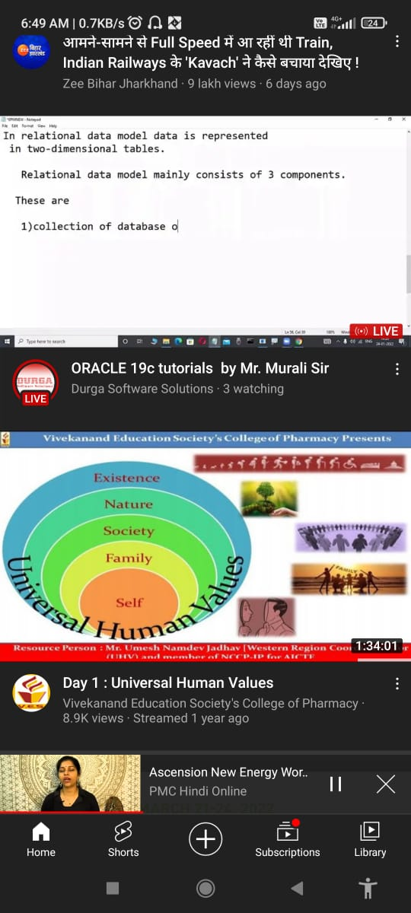

Slide 14
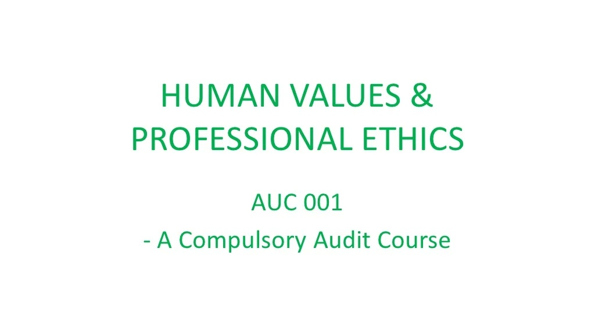

Slide 15
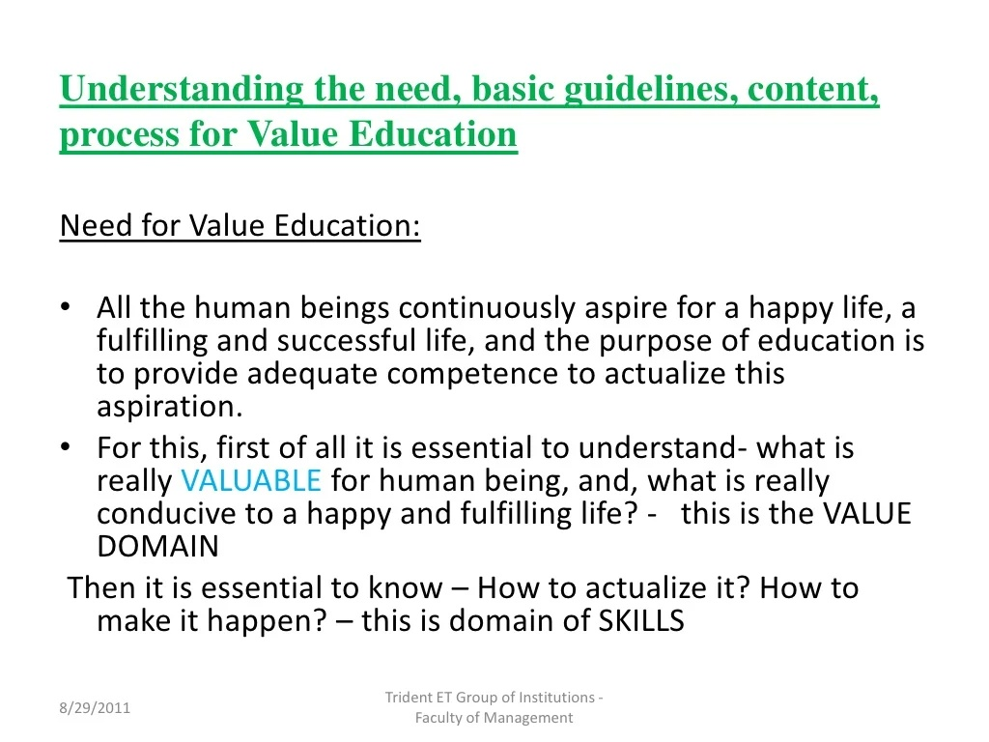

Slide 16
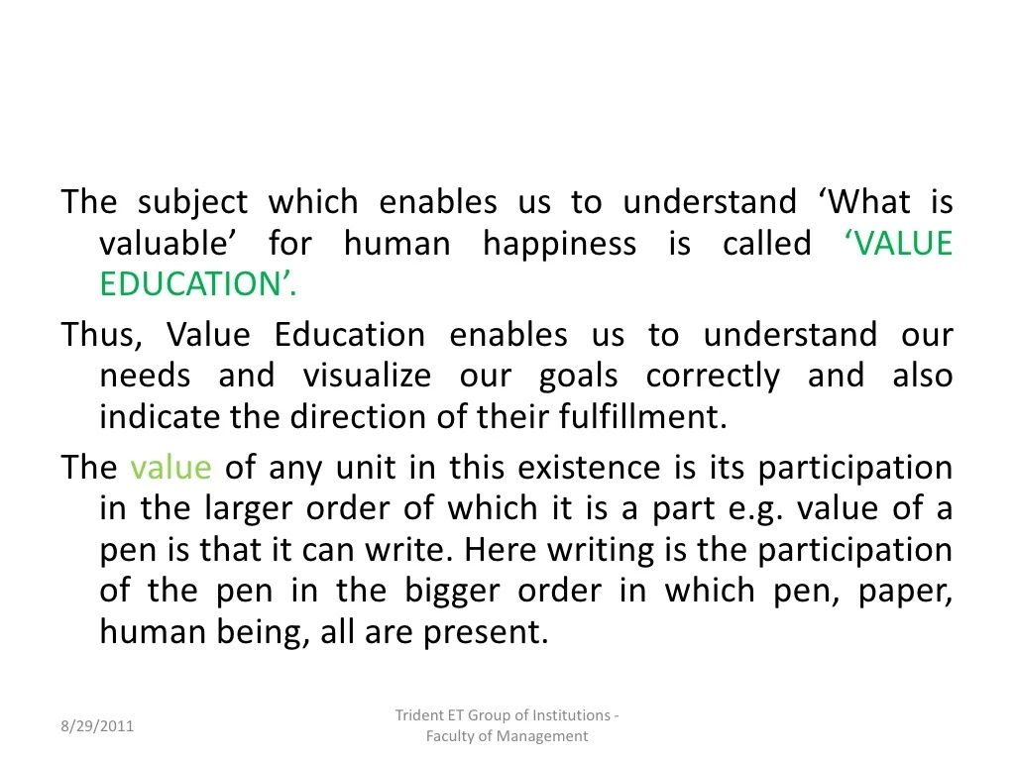

Slide 17
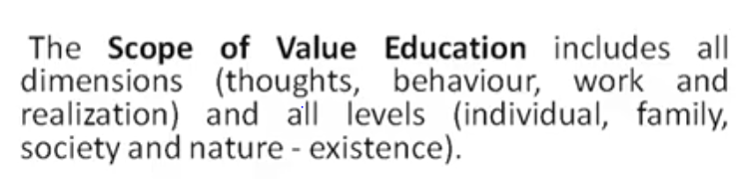

Slide 18
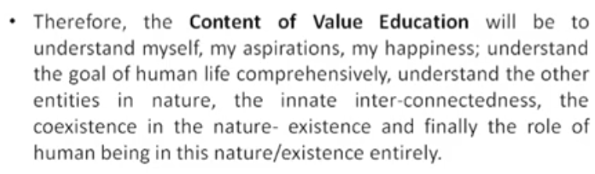

Slide 19
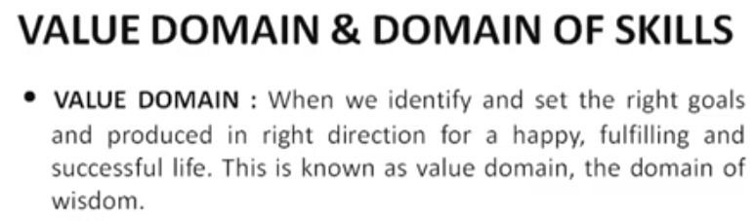
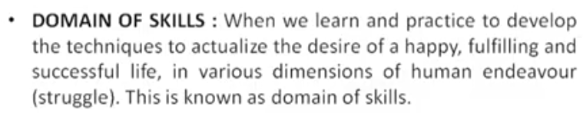

Slide 20
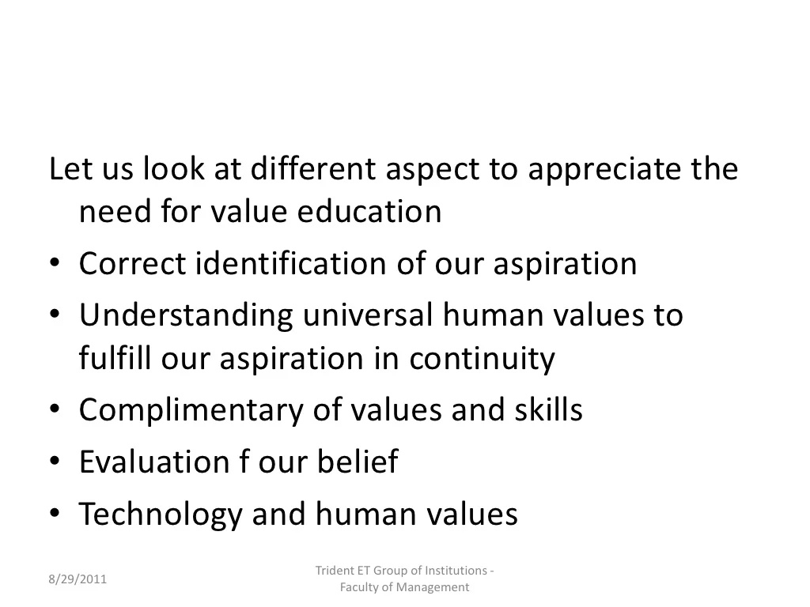

Slide 21
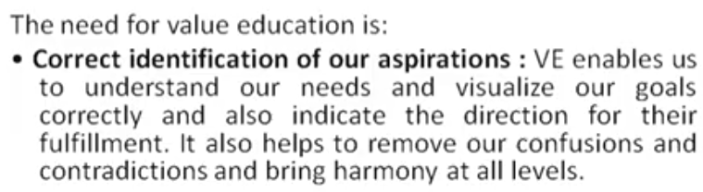
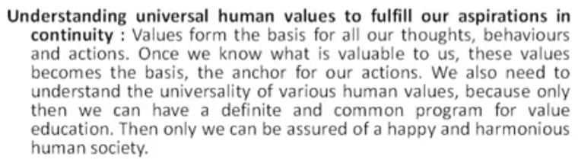

Slide 22
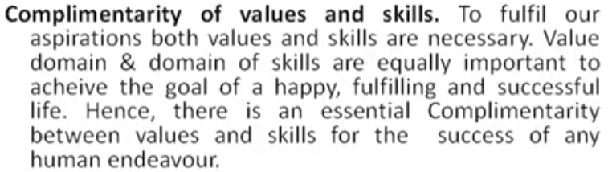

Slide 23
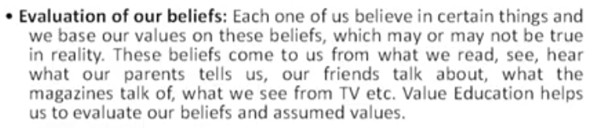

Slide 24
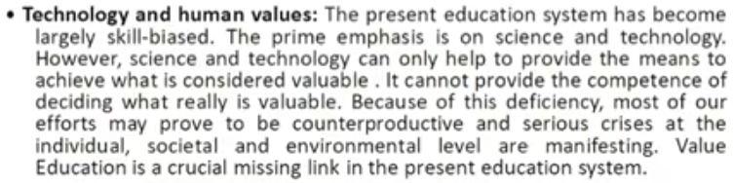

Slide 25
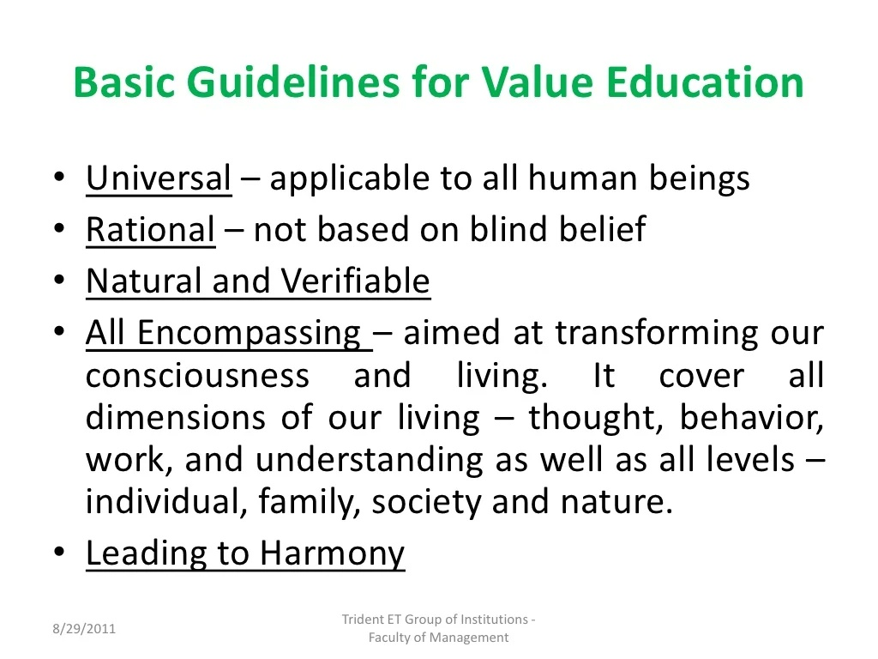

Slide 26
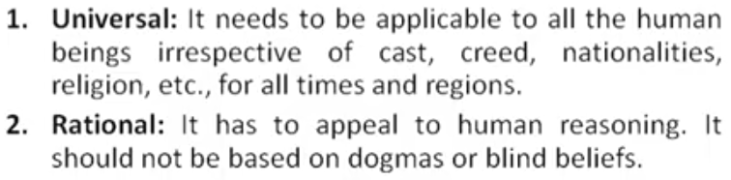

Slide 27
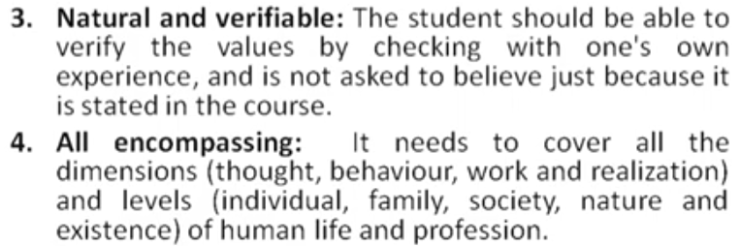

Slide 28
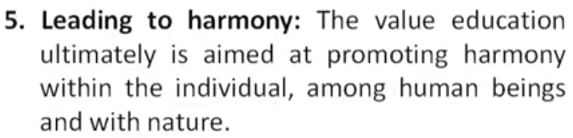

Slide 29
Human Values, Role of Human Being in the Larger Order
Individual
I have a role within myself
(eg. ensuring happiness in the self and health in the body)
Family
I have a role in my family
(eg. ensuring feeling of relationship and prosperity)
Society
I have a role in the society
(eg. to participate in social systems for ensuring justice, peace and harmony)
Nature/Existence
I have a role in nature/existence
(eg. mutual fulfilment with rest of nature)

Slide 30
It is process to find out what is valuable to me investigating within myself. Since it is me who feel happy, successful, unhappy or unsuccessful. Therefore,what is right for me is to be judged by myself . Though self exploration we get the value of ourselves. We live with different entirety (family, friends , air , soil , water , tree etc.) and we want to understand our relation with all these. For this we need to start observing inside. It soon becomes a dialog within your own Self… According to Merriam-Webster:- “ The examination and analysis of one's own unrealized spiritual or intellectual capacities.’’
Self exploration

Slide 31
The main focus of self exploration is myself ‘The Human Being’ .
Content of self exploration is just finding answers to the following fundamental questions .
1. The desire / goal , what is my (Human) desire/goal ?
What do I really want in life, what is the goal in human life ?
2. What is my programme for fulfilling the desire ?
How to fulfil it ?what is the programme to actualise the above
In short, two questions cover the whole domain of human aspirations and human desire ? Thus they form the content of self exploration.

Slide 32
Process of self exploration
1. It is a process of dialogue – between me and you, to begin with. It soon becomes a dialogue within your own self .
2. It is a process of dialog between what I am and my Natural Acceptance or what I really want to be.
3. It is a process of Self-exploration, Self-investigation Self-evaluation.
4. It is a process of knowing oneself and through the self, knowing Nature and the entire existence.

Slide 33
5. It is a process of recognizing one's relationship with every unit in nature/existence; and fulfilling that relationship.
6. It is a process of knowing Human Conduct and living according to it.
7. It is a process of living in harmony in oneself, living in harmony with others…living in harmony with entire existence

Slide 35
Purpose of self exploration
It is a process of dialogue between “what you are” and “what you really want to be”
• It is a process of self evaluation through self Investigation
• Process of knowing oneself and through that understanding entire existence.
• Process of recognizing relationship with every unit in existence.
• Process of knowing human conduct, human character & living accordingly.
• Process of being in harmony with oneself and with entire existence.
• Process of knowing innateness, & moving towards self organization & self express

Slide 36
mechaniSM OF SELF EXPLORATIon
Natural acceptance and experiential validation
NATURAL ACCEPTANCE

Slide 37
Natural acceptance implies unconditional and total acceptance of the self, people and environment.
It also refers to the absence of any exception from others.
Once we fully and truly commit ourselves on the basis of natural acceptance, we feel a holistic sense of inner harmony, tranquility and fulfillment.
2. EXPERIENTIAL VALIDATION:
Experiential validation is a process that infuses direct experience with the learning environment and content.
It may be regarded as a philosophy and methodology in which the direct experience and focused reflection of the individual helps to increase knowledge, develop skill and clarify values.
Self exploration takes place in the self and not the body.

Slide 38
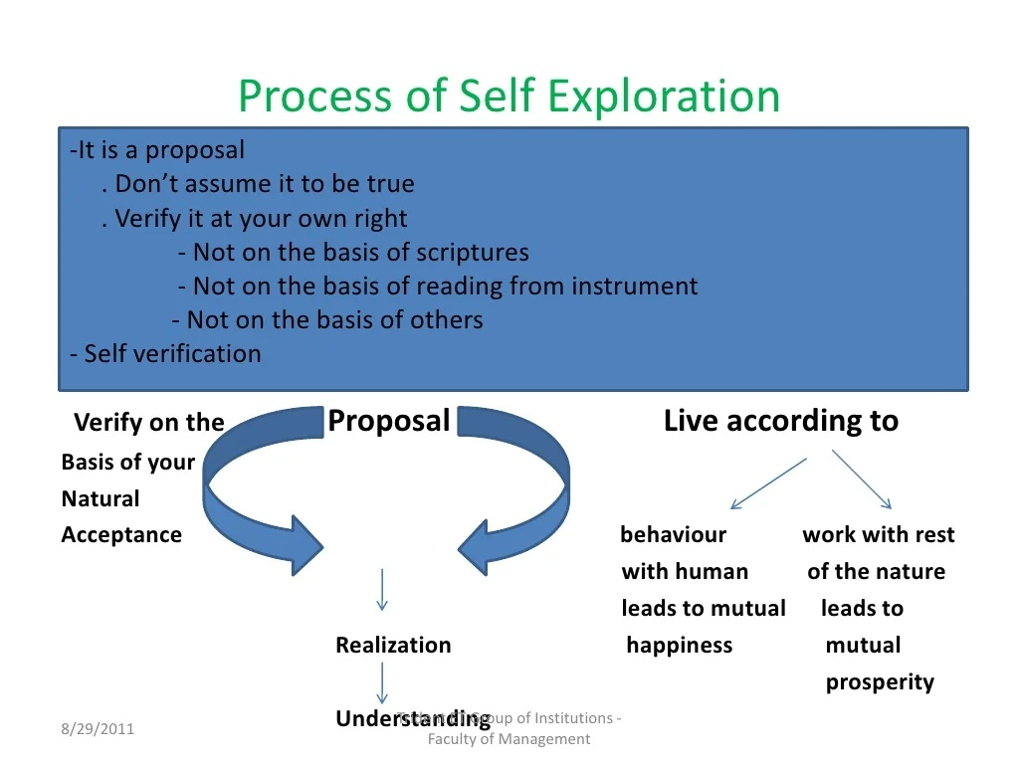

Slide 39
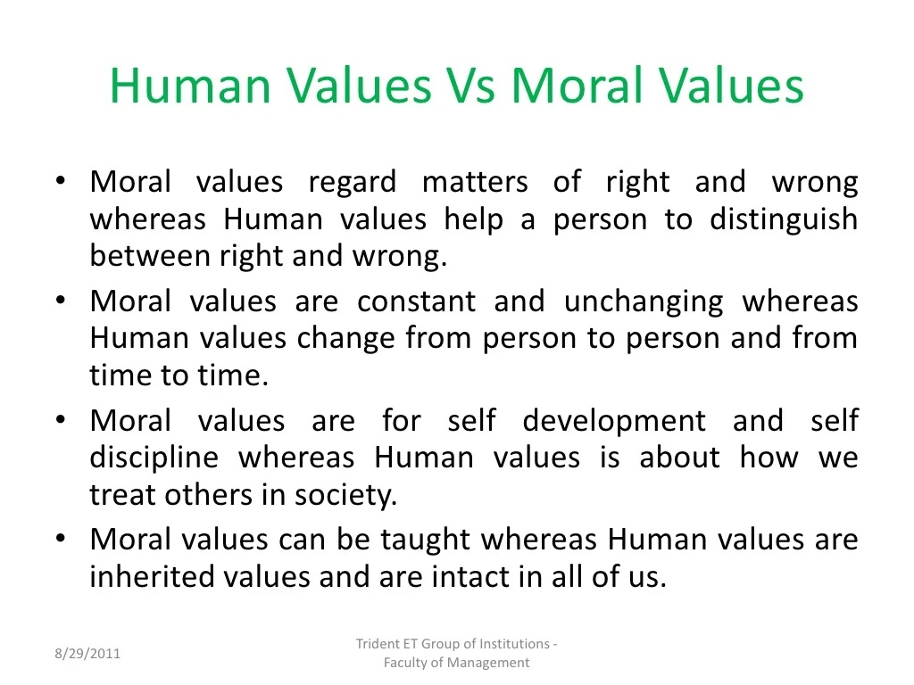

Slide 40
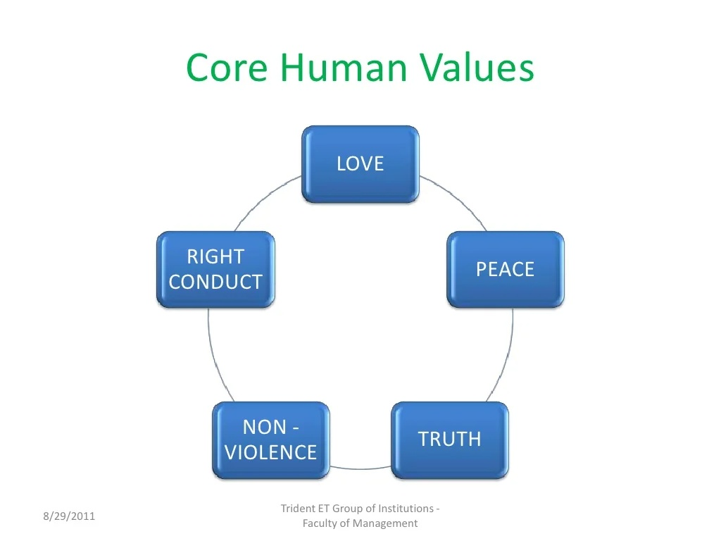

Slide 41
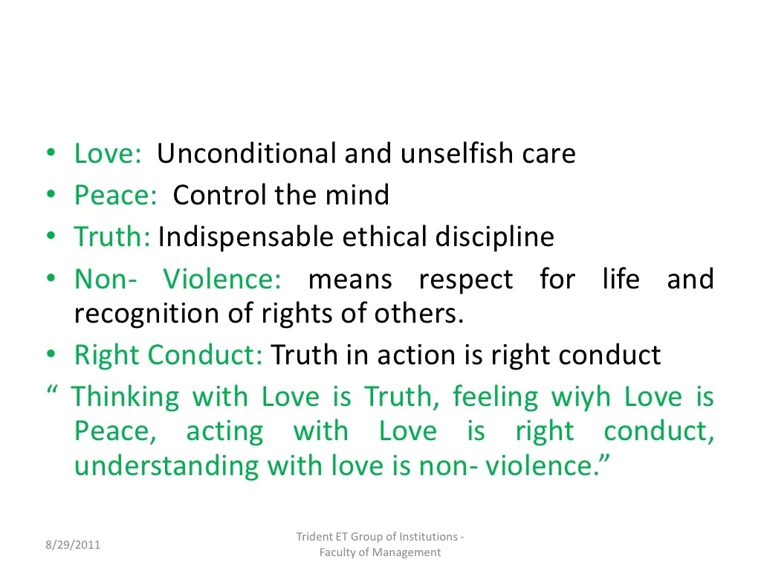

Slide 42
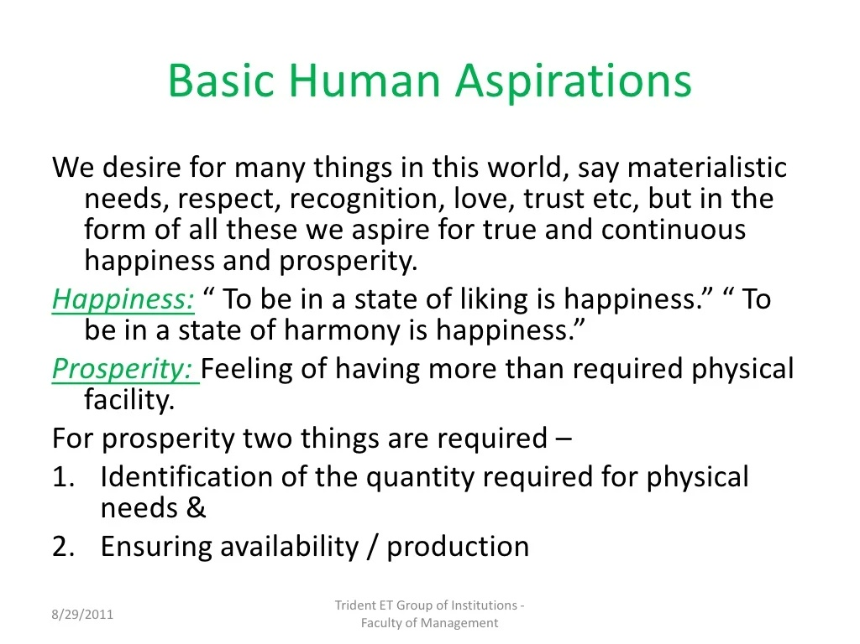

Slide 43
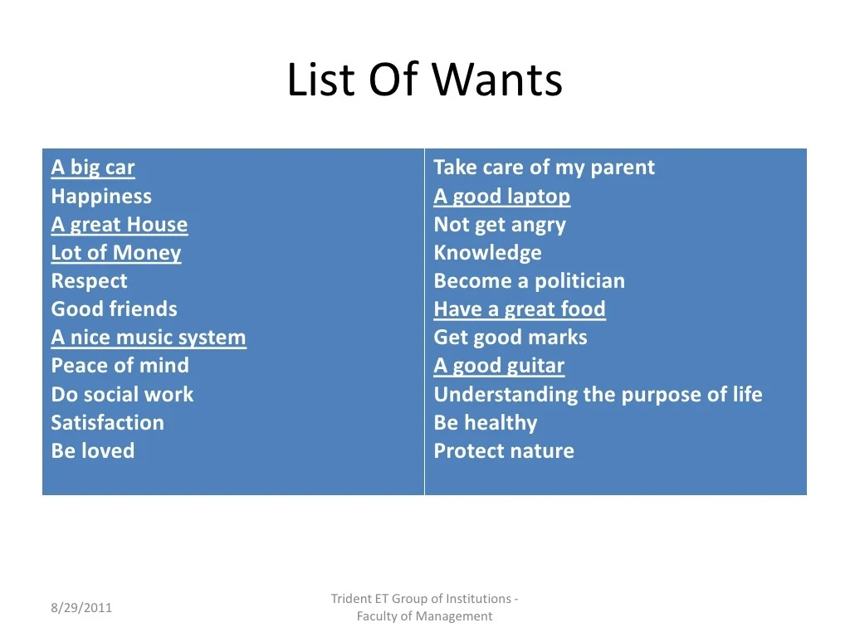

Slide 44
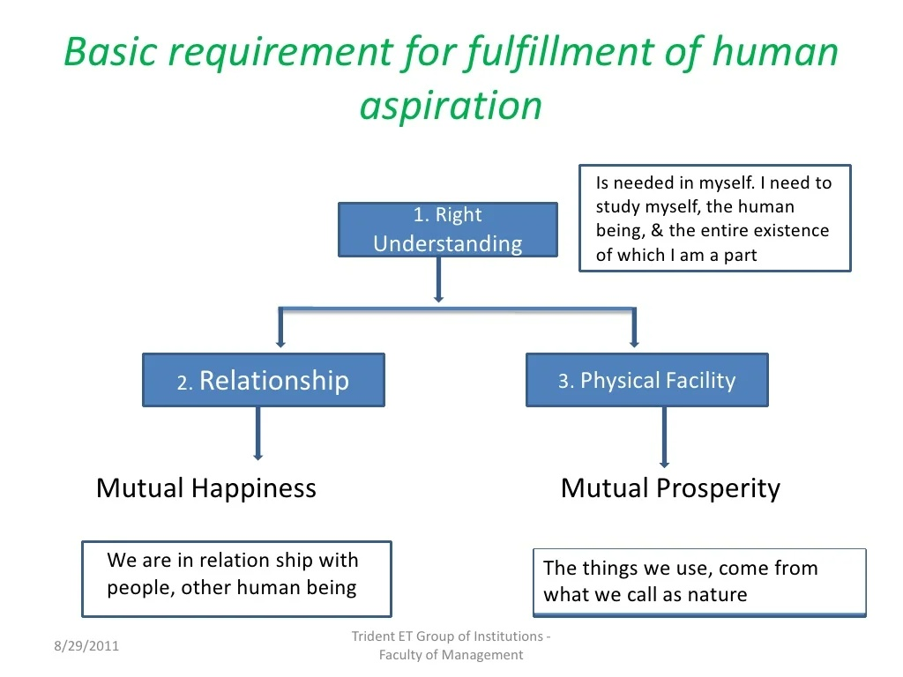

Slide 45
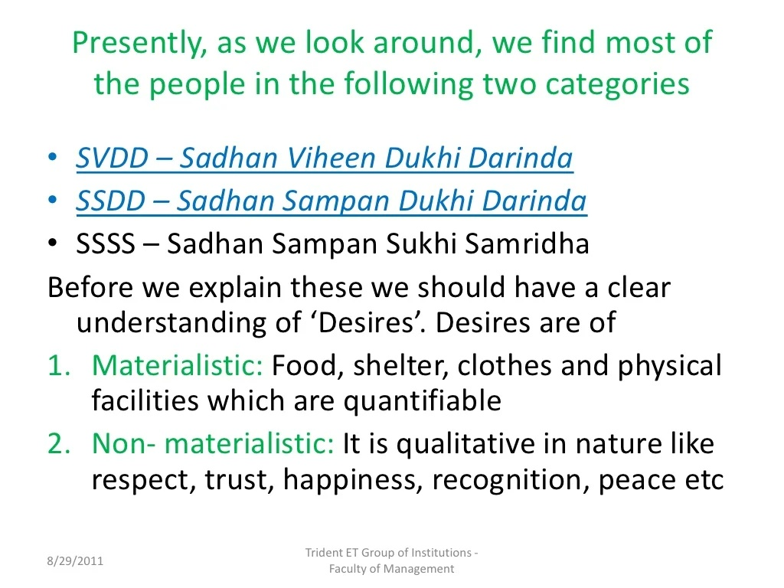

Slide 46
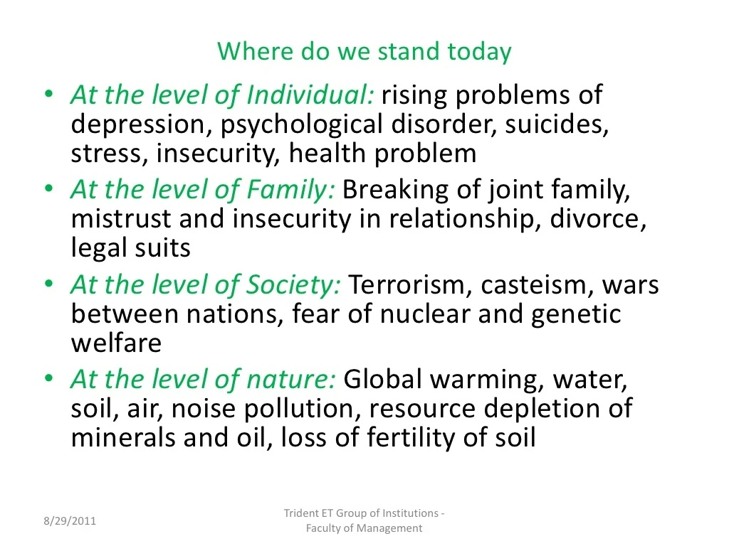

Slide 47
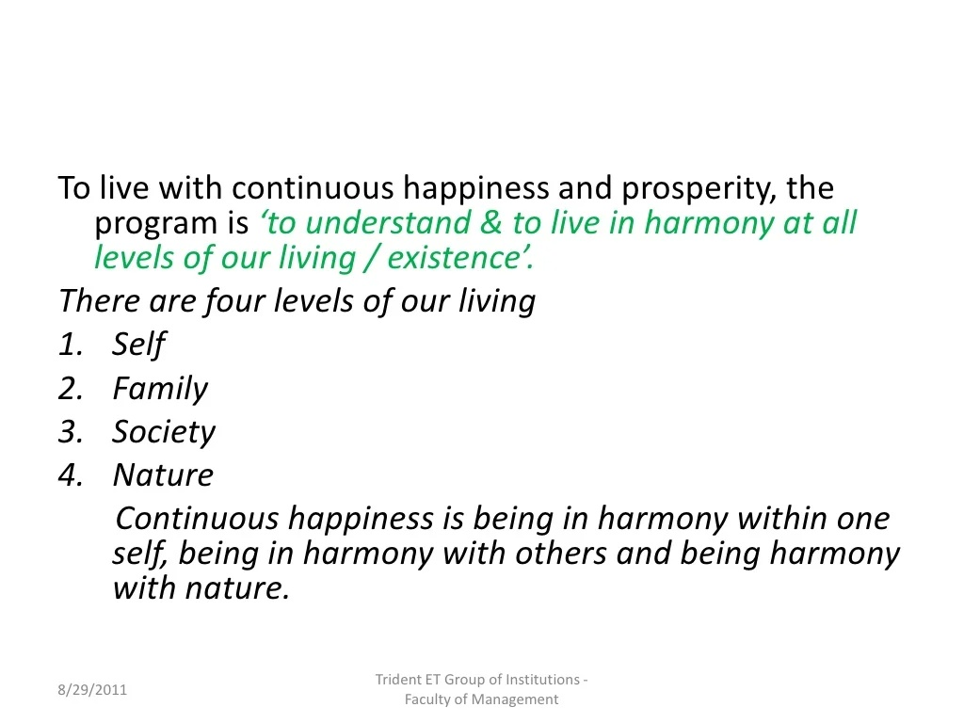

Slide 48
Right Understanding
Right Understanding helps us to maintain proper relationships with other human beings and also helps us to make a proper choice of physical facilities.
Hence the needs of all human beings consist of the need for –
Right Understanding,
Relationships and
Physical Facilities in the right order.

Slide 49
Following is a set of three Proposals based on the need for Physical Facilities:
Physical Facilities are necessary for human beings
Physical Facilities are necessary for human beings and they are necessary for animals
For e.g. : Human Beings need food, water, TV, bike, MBA degree, Relationships with family and society etc.
For e.g.: Animals need food, water, shelter from extreme climatic conditions etc.
Physical Facilities are necessary and complete for animals, while they are necessary but not complete for human beings
For e.g.: Animals need food to survive. Once an animal receives the necessary grass or fodder, its need is complete. But for human beings, the needs are incomplete. If they are hungry they want food, but they look for something tasty. Once their hunger is satisfied, they need some recreation/ physical facilities, followed by the need for relationships etc. This list of human needs is almost endless and mostly incomplete.

Slide 50
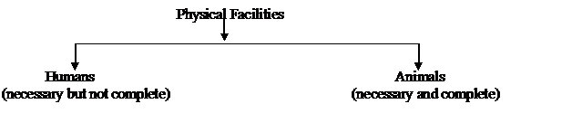

Slide 51
Importance/ Need for Right Understanding:
Right Understanding helps to create harmony at all four levels of human living. Right Understanding enables us to –
Resolve the issues in human relationships
Be prosperous
Enrich Nature
Work out our requirements for physical facilities
Correctly distinguish between wealth and prosperity
Understand the harmony in Nature
Right Understanding forms the basis on which we can work for relationships and also acquire Physical Facilities.

Slide 53
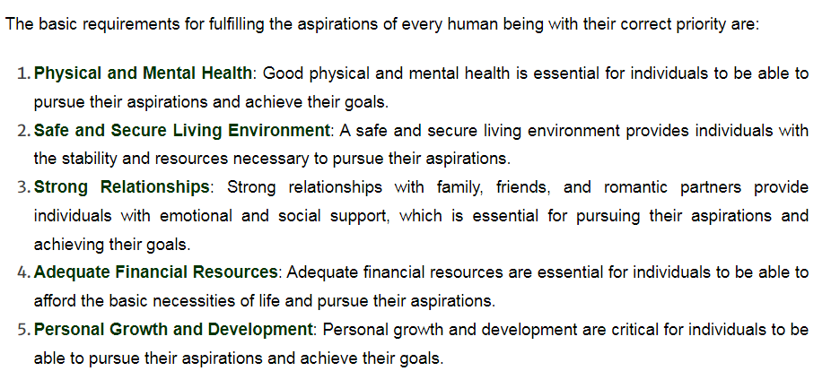

Slide 54
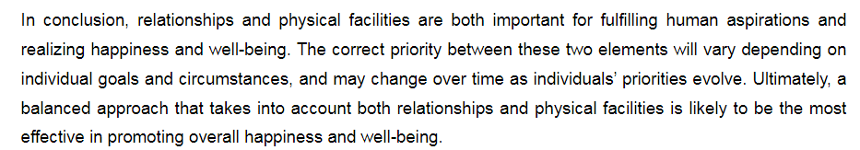

Slide 55
Exploring the Meaning of Happiness and Prosperity
As stated earlier, the proposal for happiness is: “The state or situation, in which I live, if there is harmony / synergy in it, it is Naturally Acceptable to me to be in that state / situation”.
“To be in a state / situation which is Naturally Acceptable is Happiness”. i.e. “To be in a state of Harmony / Synergy is Happiness”. i.e. Happiness = Harmony.
“The state or situation, in which I live, if there is disharmony / contradiction in it, it is not Naturally Acceptable to me to be in that state / situation”. “To be forced to be in a state / situation which is not Naturally Acceptable is Unhappiness”. i.e. “To be forced to be in a state of Disharmony / Contradiction is Unhappiness”. i.e. Unhappiness = Disharmony.

Slide 57
Exploring the Meaning of Prosperity
Prosperity is the feeling of having more than required physical facility.
There are two basic requirements:
1. Right assessment of the need for physical facility, along with its required quantity.
2. Ensuring the availability/production of more than required physical facility.
We can have a feeling of prosperity only if we are able to do the right assessment of our physical needs. The right assessment of physical needs, along with their required quantity, will come through right understanding.
Without that right assessment, the feeling of prosperity cannot be assured, regardless of the availability or accumulation of physical facility that we may have been able to do.

Slide 58
When you have a feeling of prosperity, you will naturally think of nurturing and enriching others. On the other hand, if we feel deprived then we think of exploiting and depriving others.

Slide 59
Living in Harmony at all levels of living with the help of Right Understanding:
1.At the level of Myself: Self-Exploration with the help of Natural Acceptance and Experiential Validation helps to develop a sense of Right Understanding. This right understanding helps me to understand myself clearly, and helps me to develop a feeling of Satisfaction , Prosperity and Happiness(Harmony) in Myself. 2. At the level of Family: Right understanding helps me to understand others feelings and expectations in a better way. This ensures harmony in family. 3. At the level of Society: Our family is a part of a large group of people called the Society. As we understand our relationships with others in our family, we also start understanding others in the society and can maintain fulfilling relations with everyone.
4. At the level of Nature/ Existence: We live in a large eco-system called Nature. Existence refers to all the things that exist in Nature. Once we learn to maintain harmony with the society, we also develop a feeling of concern towards the plants, trees, animals etc. in Nature. Hence right understanding leads to mutual fulfillment with Nature.

Slide 60
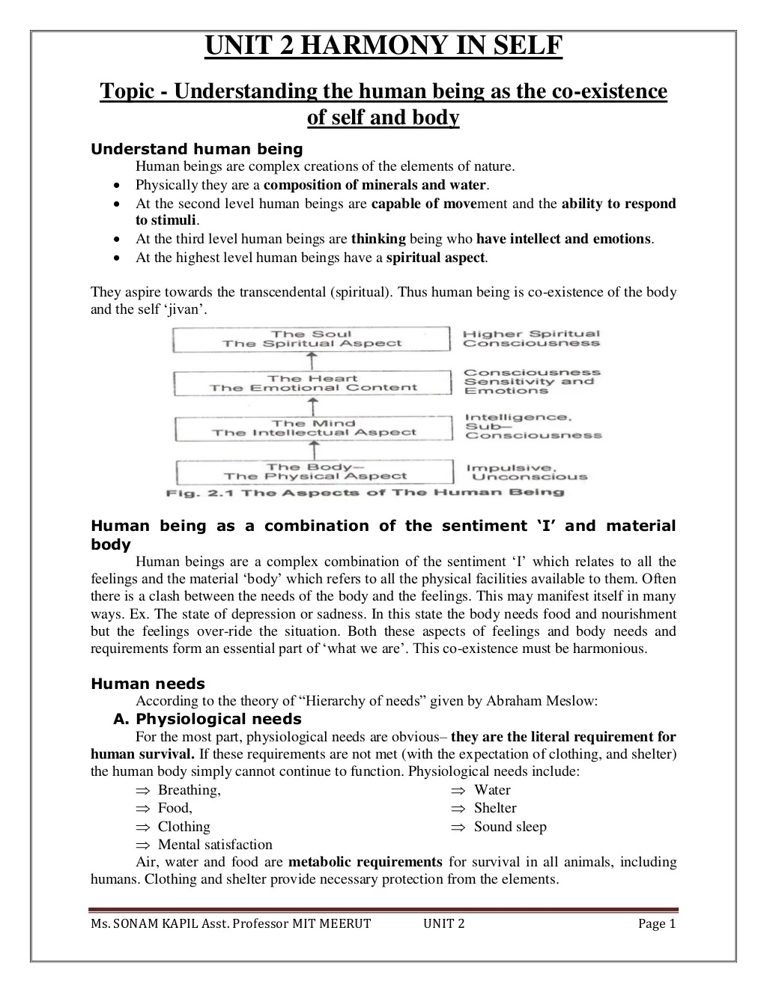

Slide 62
